Slide 1
International Islamic University Chittagong Department Of Computer Science And Engineering
Course Code: CSE-3528 Course Title: Compiler Lab
Submitted By
Group B
C201202 Farjana Akter Laila
C201211 Sanjida Binta Aziz
C201231 Jesmin Akter Nipa
C201234 Jakia Rahman
C201237 Tasnin Jabin
Submitted To
Mrs. Israt Binteh Habib
Lecturer
Dept. of CSE, IIUC

Slide 2





An Online IDE with Node JS
PROJECT TOPIC

Slide 3
Table of contents
01
Introduction
04
Implementation
02
Problem Statement
05
Result
03
06
Conclusion
System Design

Slide 4
Introduction
The Integrate Development Environment (IDE) provides an environment in which to execute specific programs written in any language. An online or web-based IDE is a compiler that allows us to compile source code and execute it online in several languages. The program will be compiled by the software, and the output will be returned to the user.

Slide 5
Problem Statement
It is common for the Program Developer, who produces the code for a specific project, to be responsible for the entire environment to present a specific project in front of anyone. This environment contains the software on which the code runs as well as the databases. So, even if the developer wants to test his code alone, he must have all of the necessary resources. To his rescue, we propose a Web Based IDE that solves all of his concerns. To view, alter, and test his code, the Developer only requires a web browser and an internet connection. As a result, he saves time and reduces the cost of creating an environment wherever he travels.

Slide 6


Software Requirements
VS Code
Node JS

Slide 7
System Design
We have used waterfall methodology to implement our project. It makes the outcome clear and well defined. In this project development, the three important aspects need to be emphasized are JavaScript, Node JS and HTML. The software that has been used in this project is JavaScript, Node JS, HTML is used to Compile and execute the client program. It provide the IDE for client to compile their program.

Slide 8
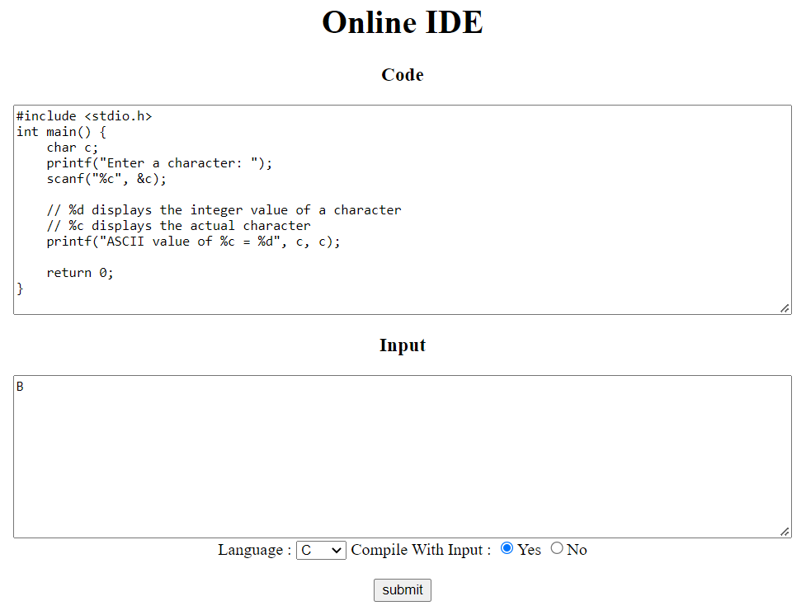
Implementation

Slide 9

Result

Slide 10
Future Scope
Limitation of programming language.
More functions need to be added for better interface design.
Loading time of compiler should be faster.

Slide 11
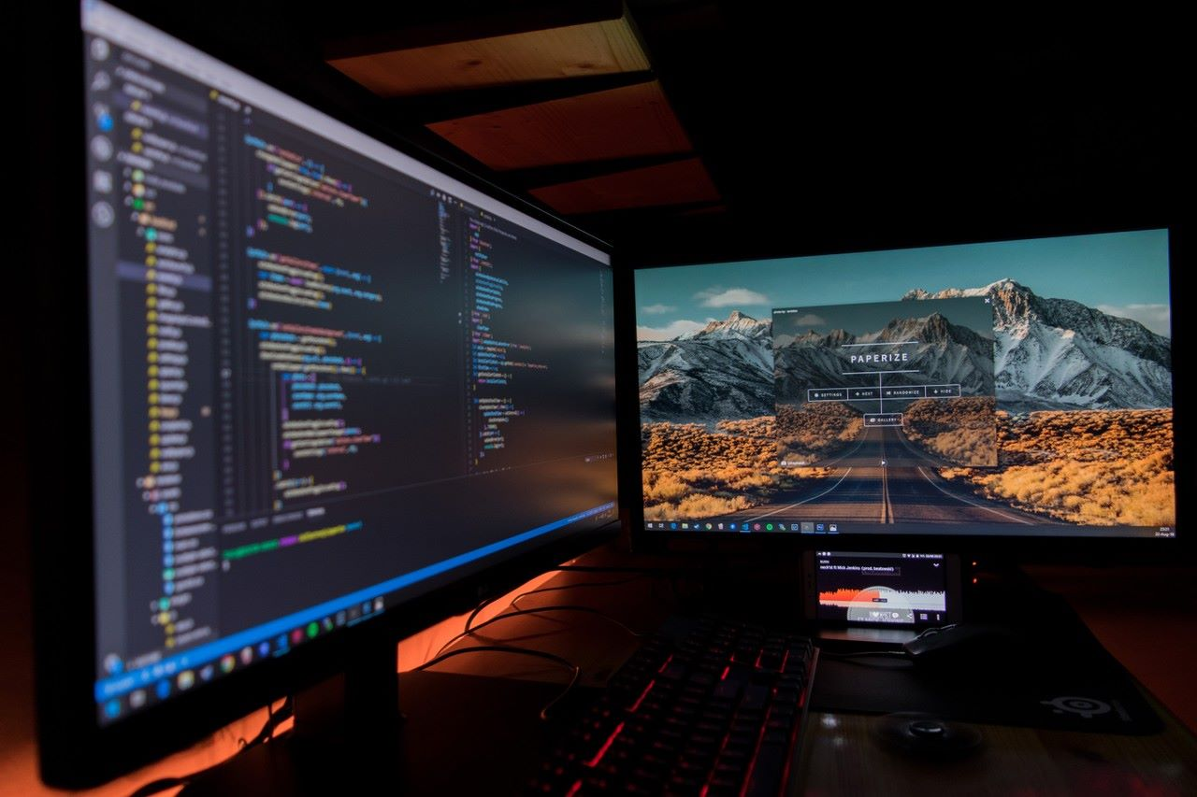
Conclusion
The project's main goal is to provide a centralized compilation system. It will also serve as a centralized repository for all written code.The process of maintaining and distributing dynamic usernames and passwords will be substantially streamlined.

Slide 12
THANK YOU!

